Slide 1
UE17CS490A – Capstone Project Phase – 1
Project Progress Review #2
(Project Requirements Specification and Literature Survey)
Project Title : Style-Consistent Kannada Font Generation
Project ID : PW21KS04
Project Guide : Prof. K S Srinivas
Project Team : 1. Saahil B Jain - PES1201700241
2. Jeevana R Hegde – PES1201700633

Slide 2
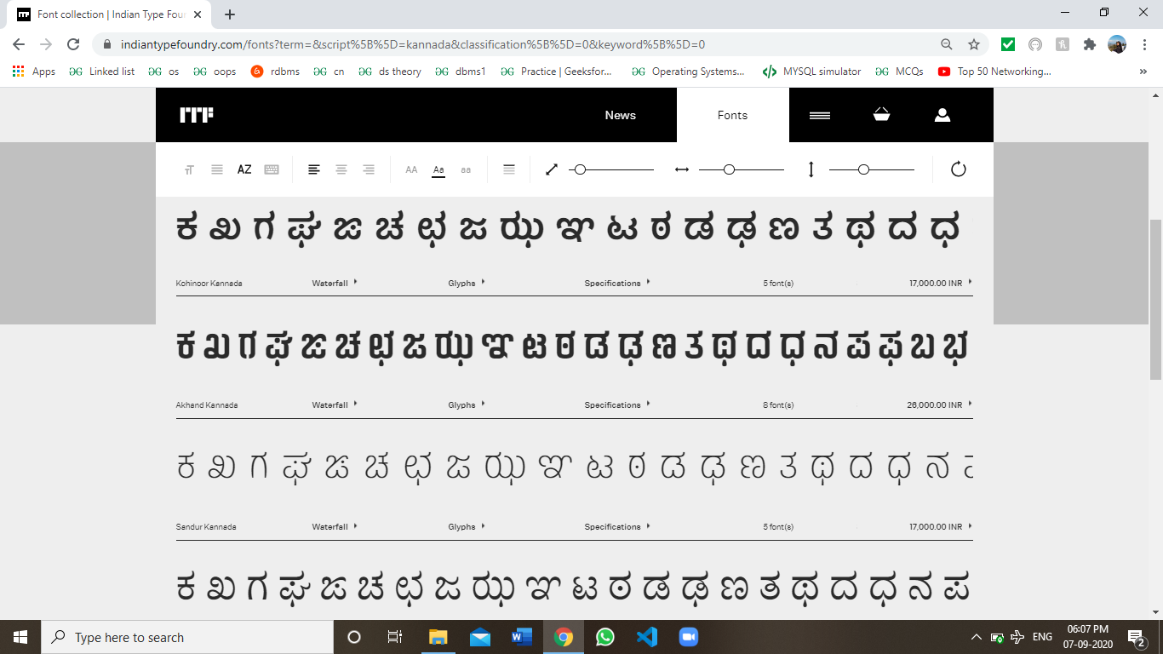
Abstract and Scope
Problem statement:
Indian languages currently have a limited set of fonts available.
Generation of new fonts is a manual process where designers use tools to draw letters in a different ways.
The project goal is to automate the generation of new fonts for the Kannada scripts while simultaneously ensuring generation of maatras.
We plan to also try and achieve style transfer from preexisting fonts for other languages like English.

Slide 3
Suggestions from Review - 1
Suggestions and remarks given:
Need to get a clear idea on our user class.
To not limit it to only Kannada language.
Scope:
Currently font generation is done where the designers must manually draw and further trace Glyphs(characters) using software tools such as Font Developer.
For each font, the time varies from a couple of hours to a couple of days.

Slide 4
Suggestions from Review - 1
Our project aims to automate this process while simultaneously trying to incorporate style inspired from fonts available for other languages.
Hence makes the process less time consuming, more efficient(using style consistency) and provides a varied set of options to choose from.

Slide 5



User Classes and Characteristics
User class:
Television channels - A crisp, bold and clear font to depict the name of the channel with the logo on the right top corner.
Newspapers, Magazines and Books - A large heading on the front cover page and consecutively on each page to mark the name of newspaper. Also includes a consistent font style of the entire text or content.
Movies - An eye catchy font to grasp public attention with a single glance.
Company name font designers - Generic Kannada brand names to attract local audience.

Slide 6
Constraints / Dependencies / Assumptions / Risks
Constraints:
Processing power required is considerably low. But increase in image size increases model size exponentially.
Dependencies:
1 set of Telugu alphabets with all maatras.
Fonts of other languages.
Assumptions:
Style transfer is possible - Taking inspiration from previously existing font styles from other languages.
Further adding other languages like Telugu.
Risks:
Ability to create fonts for complex alphabets of Telugu language.
Apply style transfer from fonts from other languages.

Slide 7
Functional Requirements
Input functionality:
A text input of a word / sentence / paragraph as a whole in Kannada language.
Output functionality:
Same word / sentence / paragraph in multiple fonts which are automatically generated.
The user can pick whichever suits best from the set of options.

Slide 8
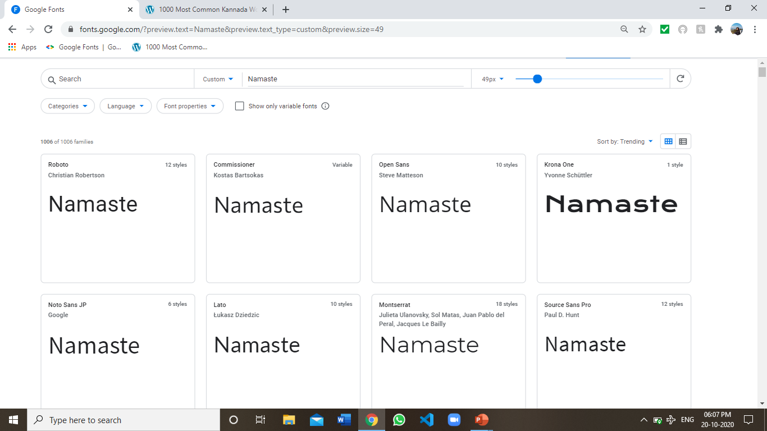
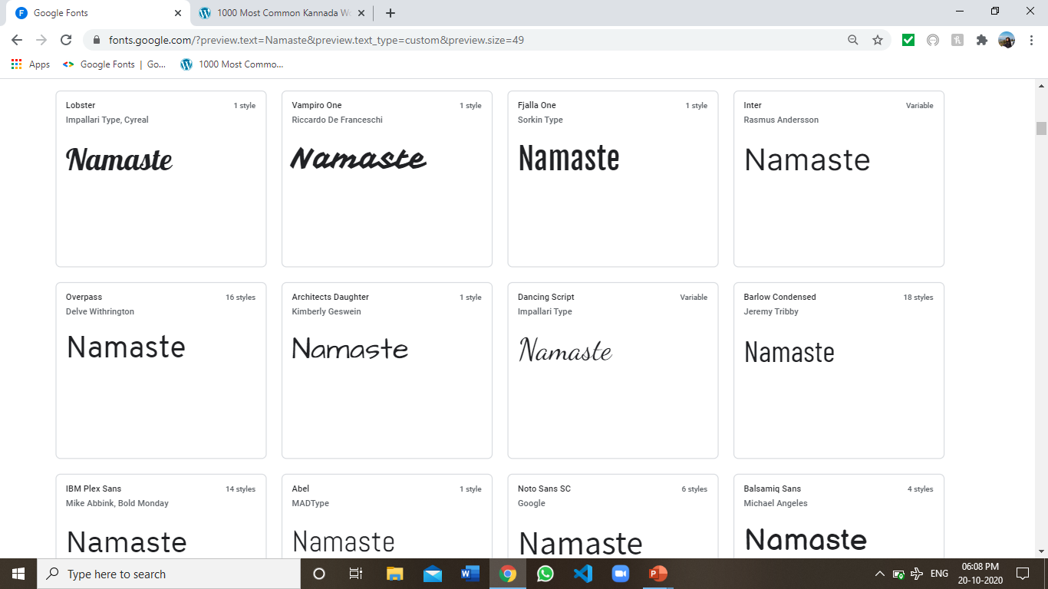
Non - Functional Requirements
Inspired UI/UX:

Slide 9
Literature Survey
A critical assessment of the research that has been conducted on the topic.
4 – 5 recently published research papers/products.
Summarize the individual papers/products with as much detail as each deserves, depending up on its relative importance in the overall literature on the topic.
Minimum 4 slides on each paper/product is required.

Slide 10
Literature Survey
The survey should be organized into categories.
Supporting and against the particular hypothesis.
Some alternative hypothesis.

Slide 11
Discussion
The strengths or weaknesses in the methods of the studies reviewed should be highlighted.
Include the relevant similarities and differences between papers/products.

Slide 12
Summary of Literature Survey
A conclusion should then state clearly the main conclusions of the review and give a clear explanation of their importance and relevance.
Give a glimpse of the proposed methodology.

Slide 13
Literature Survey
Research paper
[1] Eric Bernhardsson, “Deep-fonts”, Jan. 21,2016. Available:
https://erikbern.com/2016/01/21/analyzing-50k-fonts- using-deep-neuralnetworks.html [Accessed Oct. 04, 2020]
Summary:
The goal of the paper is for new font generation using neural networks.
The data required to do the same is about 56443 different fonts for training your model and further generating new fonts. Does the required job of new font generation with a low diversity.

Slide 14
Literature Survey
The fonts we have seen are measured based on three factors:
Style consistency: The fonts that have the same style over all characters.
Legibility: The generated fonts are legible compared to the other methods.
Diversity: The generated fonts have a diversity which is different from the training images.

Slide 15
Discussion
Strengths:
Enough data is present. Hence, slight modifications lead to the generation of significantly large number of fonts with high legibility.
Style consistency is reasonable.
Weaknesses:
There is an extremely high data dependency.
Diversity is quite low.

Slide 16
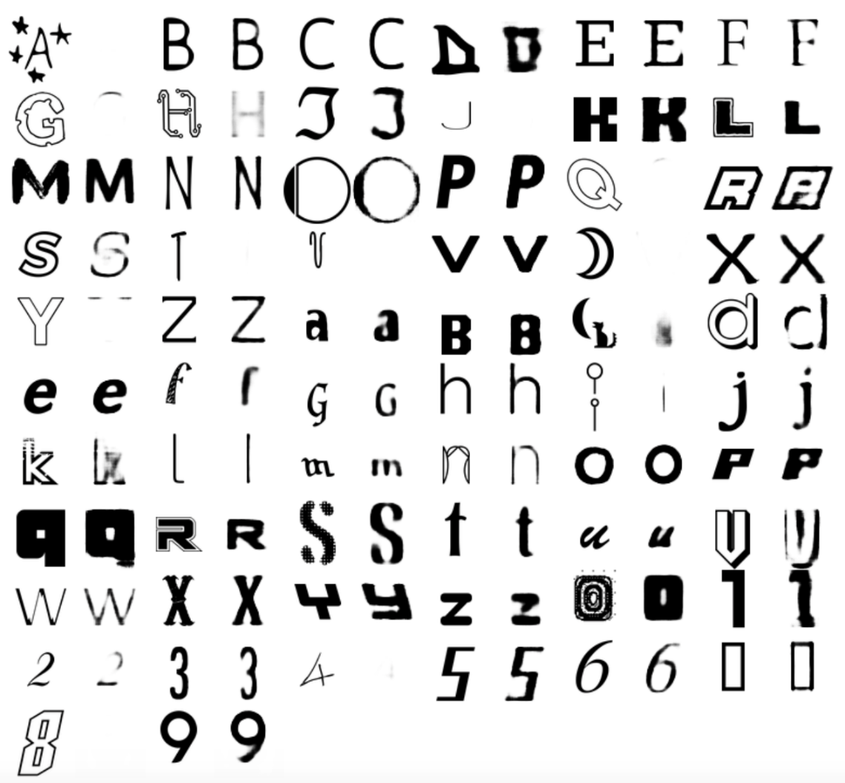
Literature Survey

Slide 17
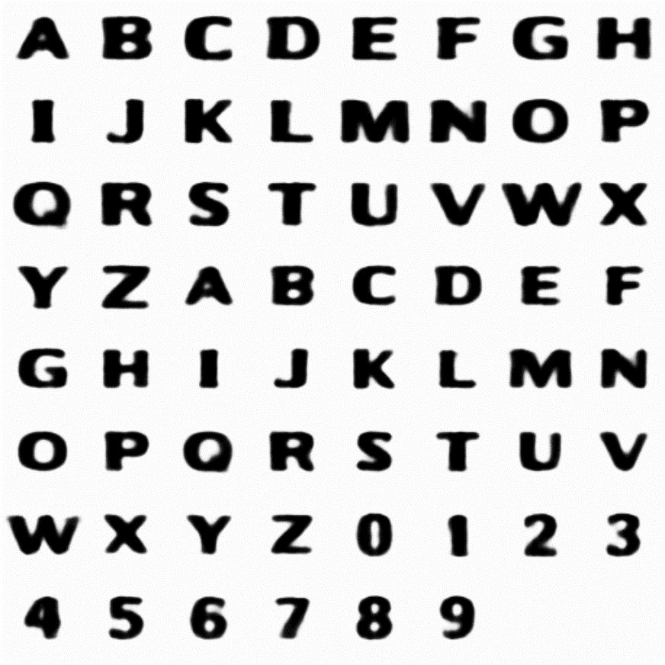
Literature Survey

Slide 18
Literature Survey
Research paper
[2] Hideaki Hayashia, Kohtaro Abea, Seiichi Uchidaa, GlyphGAN, Department of Advanced Information Technology, May 30, 2019. Available:
https://arxiv.org/pdf/1905.12502.pdf [Accessed Sep. 04, 2020]
Summary:
The goal of this paper is new font generation. However this is done using deep convolutional generative adversarial networks(a comparatively newer concept).
The data requirement is about 6561 different fonts.
This paper provides a significant benchmark to our project.

Slide 19
Discussion
Strengths:
Better legibility compared to deep-fonts.
Style consistency is the same.
More diversity in available in the fonts compared to deep-fonts.
Weaknesses:
High data dependency is present, which is unavailable for Indian languages like Kannada.
The concept of style transfer is not present.

Slide 20
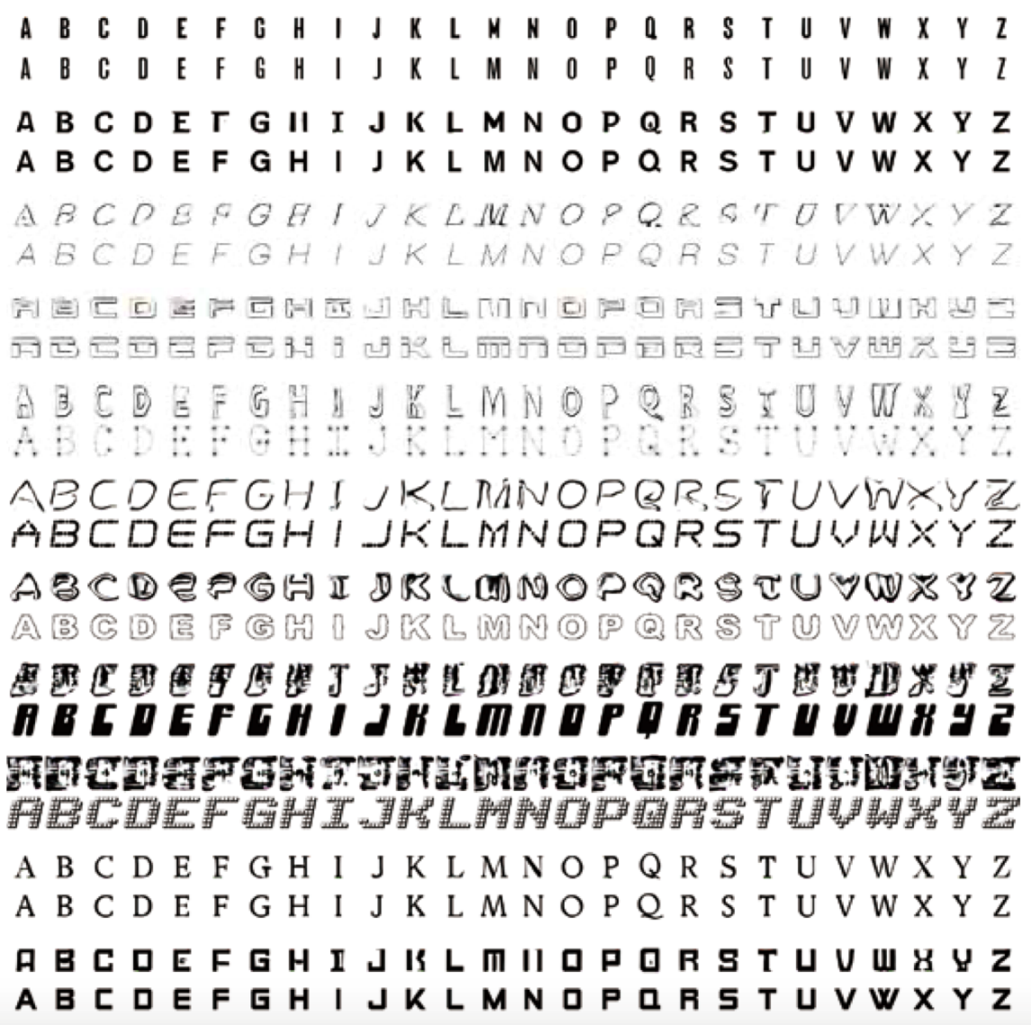
Literature Survey

Slide 21
Discussion
Similarities:
Method | Deep fonts | GlyphGAN
Goal | New font generation | New font generation
Style consistency | 0.47 | 0.47
Differences:
Method | Deep fonts | GlyphGAN
Data requirement | 56443 | 6561
Legibility | 72.51 | 83.90
Diversity | 0.33 | 0.61

Slide 22
Literature Survey
Article in Online Encyclopedia
[3] Alexander Mordvintsev, Ettore Randazzo, Eyvind Niklasson, Michael Levin, “Growing, Neural Cellular Automata”, Feb. 11, 2020. [Online], Available: https://distill.pub/2020/growing-ca/ [Accessed Sep. 02, 2020]
Summary:
The goal is of emoji regeneration using neural cellular automata.
This paper acts as the starter of how to get our project started. Hence plays a vital role in our project.

Slide 23
Discussion
Strengths:
Good emoji generation from just a single point.
Regenerative abilities is present i.e. can complete the emoji if part of it is missing.
Can generate fairly complex emojis.
Models are quite small.
Weaknesses:
No new generation as such. Just builds a model to create the exact input.
Every emoji requires a separate model.

Slide 24
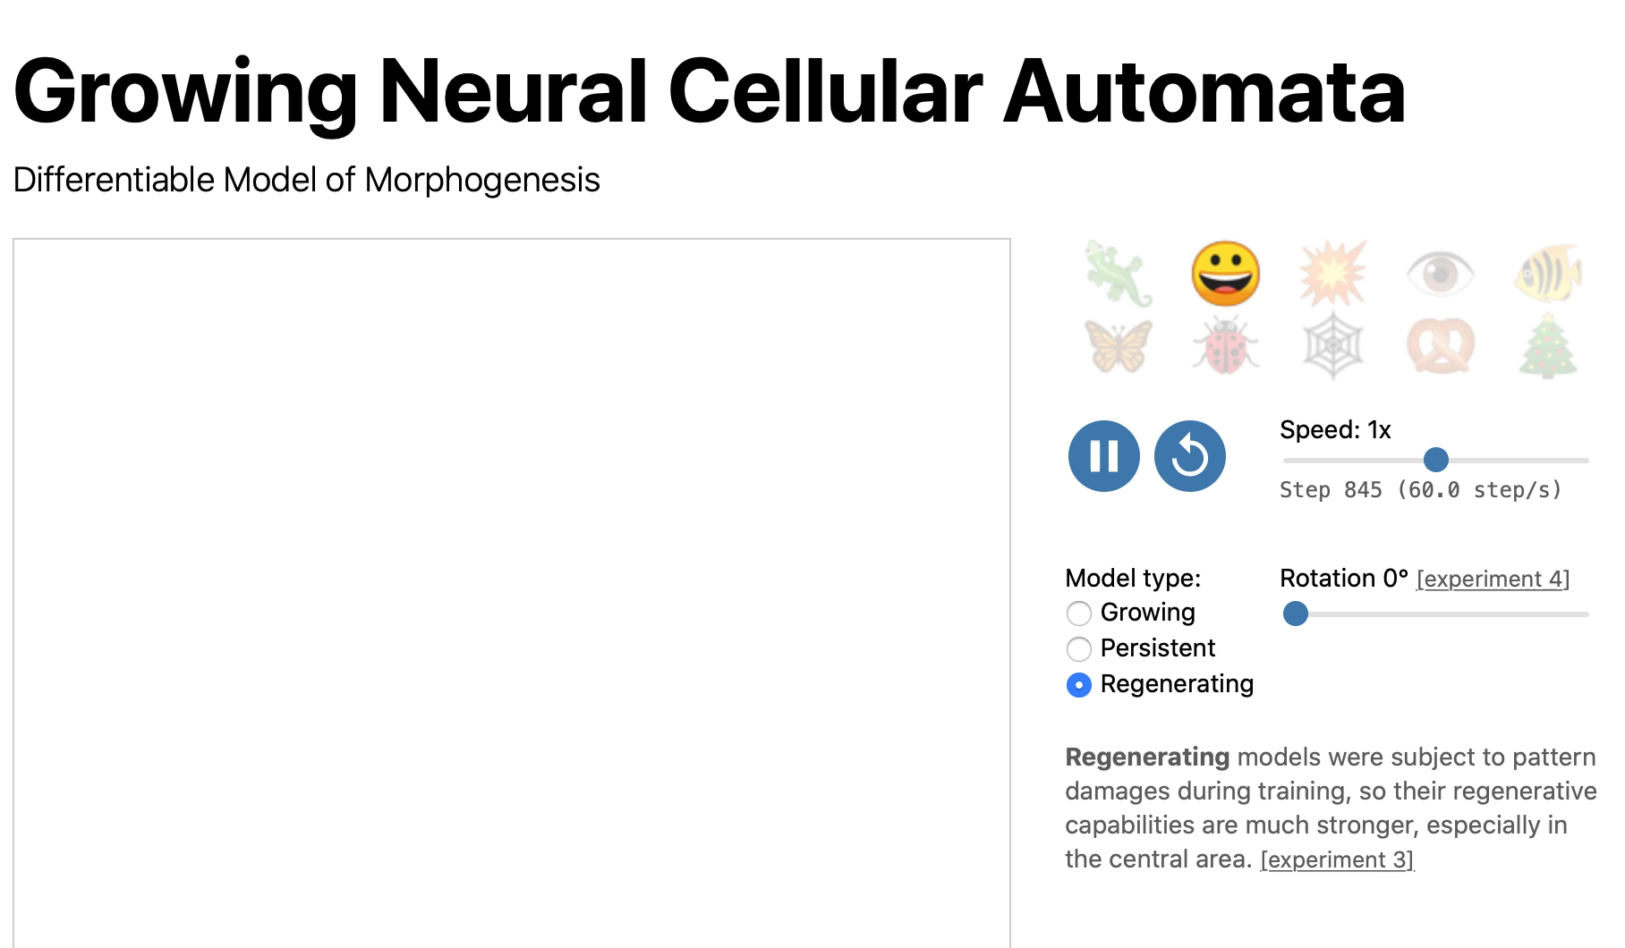
Literature Survey

Slide 25
Literature Survey
Article in Online Encyclopedia
[4] Alexander Mordvintsev, Ettore Randazzo, Eyvind Niklasson, Michael Levin, “Growing, Neural Cellular Automata”, Feb. 11, 2020. [Online], Available: https://distill.pub/2020/selforg/mnist/ [Accessed Oct. 07, 2020]
Summary:
The goal is to classify MNIST Digits using neural cellular automata. This is proposed by the same authors as the previous paper. However it focuses on classifying MNSIT Digits as opposed to generation and regeneration.

Slide 26
Strengths:
Good digit classification which is the main goal.
It can identify digits within patterns as well.
Weaknesses:
No new generation as such. Just builds a model to classify input.
Uses colour to distinguish. Hence, adding more classes reduces accuracy.

Slide 27
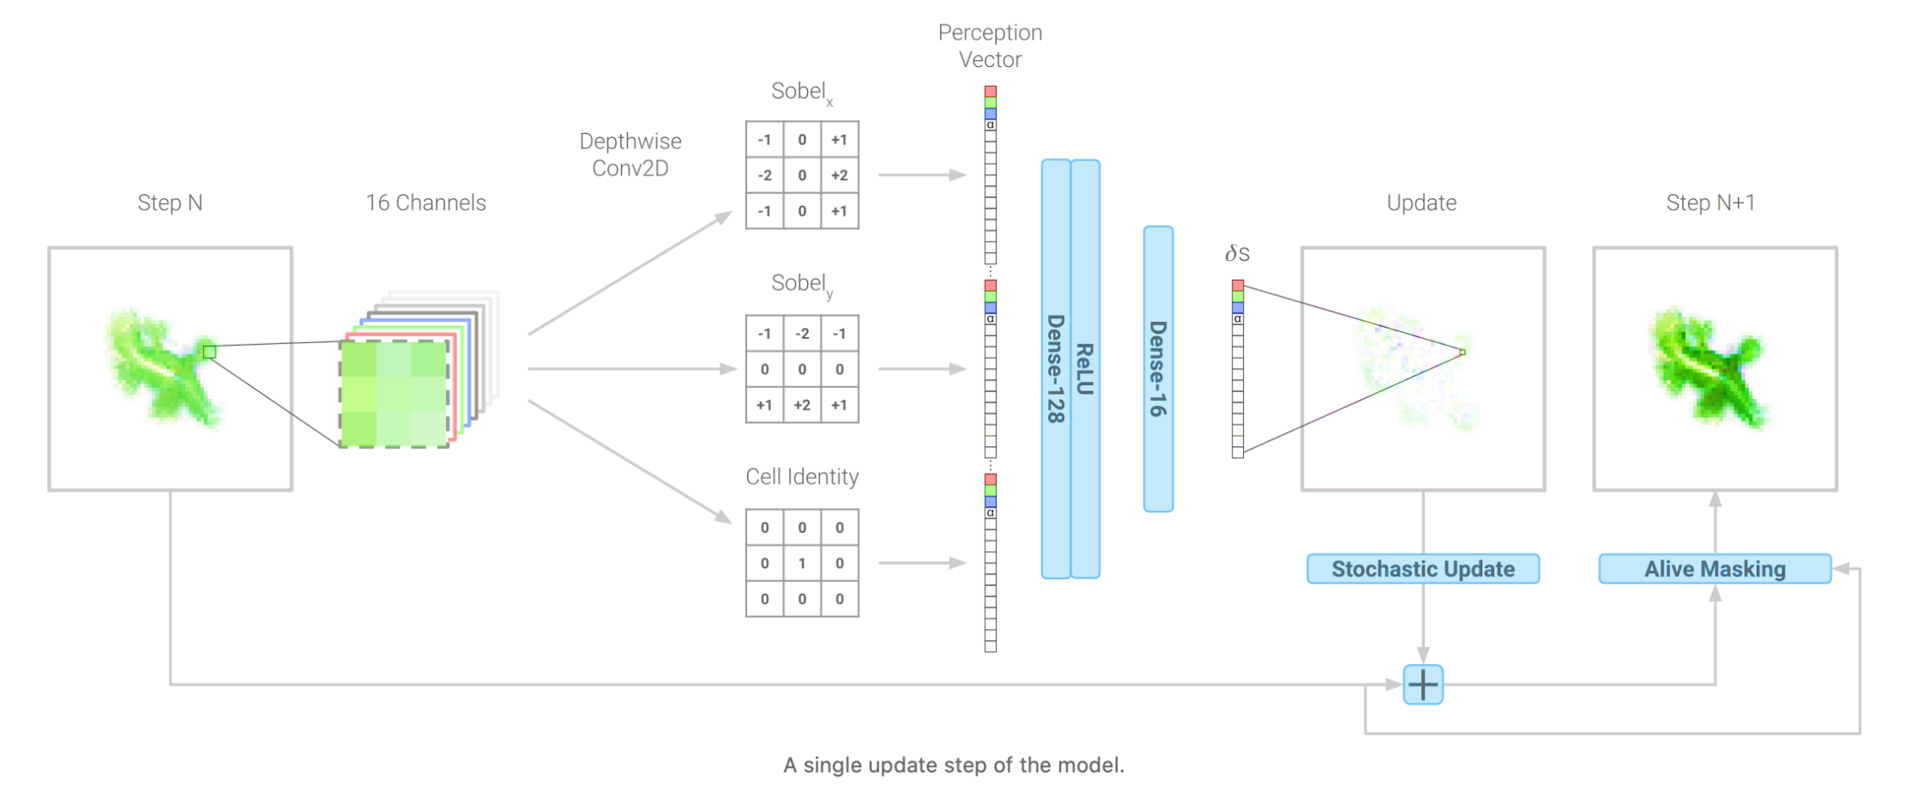
Summary of Literature Survey
Proposed architecture:

Slide 28
Summary of Literature Survey
Proposed solution:
We plan to use Neural Cellular Automata to solve the problem statement.
We will represent each cell state as a vector of 16 real values.
Then we learn an update rule for each cell using its neighbours.
Applying this update rule multiple times will help generate the given font.
Slight moderations in the feature extraction can result in unique fonts.

Slide 29

DEMONSTRATION:

Slide 30
References
References
Article in Online Encyclopedia
[1] Alexander Mordvintsev, Ettore Randazzo, Eyvind Niklasson, Michael Levin, “Growing, Neural Cellular Automata”, Feb. 11, 2020. [Online],
Available: https://distill.pub/2020/growing-ca/ [Accessed Sep. 02, 2020]
Journal Article Abstract
[2] Koen Janssens, “Network Cellular Automata—A Development for the Future?”, Computational Materials Engineering, 2007. [Online], Available:
https://www.sciencedirect.com/topics/computerscience/cellularautomata [Accessed Sep. 03, 2020]
Research paper
[3] Hideaki Hayashia, Kohtaro Abea, Seiichi Uchidaa, GlyphGAN, Department of Advanced Information Technology, May 30, 2019. Available:
https://arxiv.org/pdf/1905.12502.pdf [Accessed Sep. 04, 2020]
Research paper
[4] Eric Bernhardsson, “Deep-fonts”, Jan. 21,2016. Available:
https://erikbern.com/2016/01/21/analyzing-50k-fonts-using-deep-neural networks.html [Accessed Oct. 04, 2020]

Slide 31
Any other information
Provide any other information you wish to add on.
Note: Changes can be made in the template, with the consent of the guide for inclusion of any other information.

Slide 32
Thank You

